Slide 1
Government Price Controls: Price Ceilings
Steven Suranovic
George Washington University

Slide 2
Types of Government Price Controls
Price Ceiling (L20) – a maximum price that can be charged for a product in a market
Price Floor (L21) – a minimum price that can be charged for a good or service in a market
Price Support (L22) – a price floor for a good in which the government purchases excess supply

Slide 3
Government Motivation
If the government (or the people) believe that the price of a good or service is too high
Then set a price ceiling to prevent high prices
If the government (or the people) believe that the price of a good or service is too low
Then set a price floor or price support

Slide 4
Common Price Ceilings
Rent control in major cities
California, New York, New Jersey, Maryland and Oregon allow rent control
37 US states prohibit rent control → the issue is controversial
Prop 21 in CA in Nov 2020 to expand rent control failed – 60% against it
Price stabilization for necessities in poor countries
Keep prices of rice and other essentials low
General wage and price controls to combat inflation (US 1970s)
Price Gouging Laws in Emergencies
Prevent sudden price increases and profiteering

Slide 5
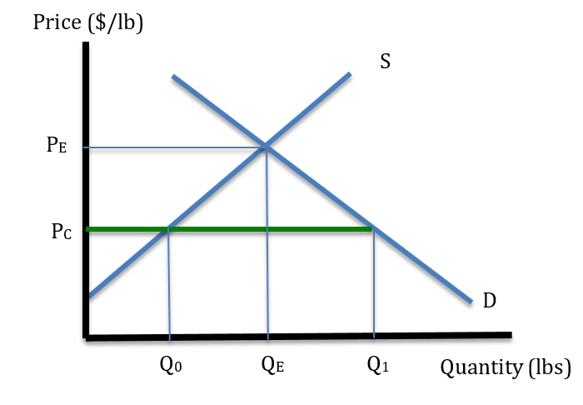
Effects of Price Ceilings
If a price ceiling is set higher than P_{E} the ceiling is non-binding and has no effects
A binding price ceiling is one set below the market equilibrium price which will have an effect.
Suppose a price ceiling is set at P_{C} and that everyone abides by the law
P_{C} is a constraint on the market
P_{E} is the “free market” price because there are no constraints imposed

Slide 6
Effects of Price Ceilings
At P_{C}, consumer demand rises to Q₁
At P_{C}, producer supply falls to Q₀
The difference, Q₁ – Q₀ is called excess demand
Excess demand is unsatisfied because there is not enough supply
Q₀ is the amount traded in the market
That means that the amount consumed in equilibrium in this market is Q₀

Slide 7
Effects of Price Ceilings
Must determine how the quantity Q₀ will be allocated to the consumers – who gets it?
Method 1 – first-come, first served
This results in lines or queues as people try to be early enough in line
Method 2 – issue quota tickets
If there are 1 million people demanding 3 million pounds but there are only 1 million pounds for sale, then give every person a 1 unit ticket

Slide 8
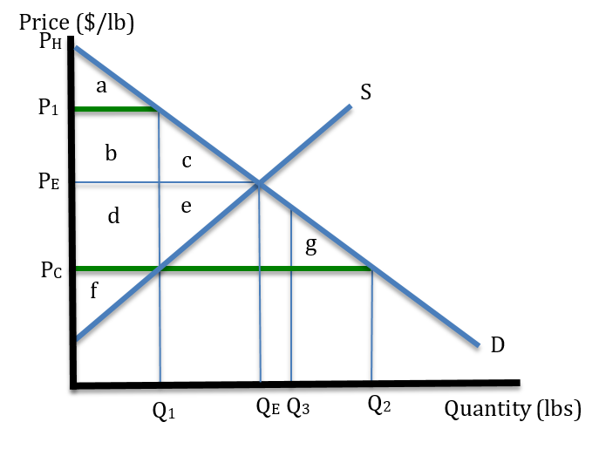
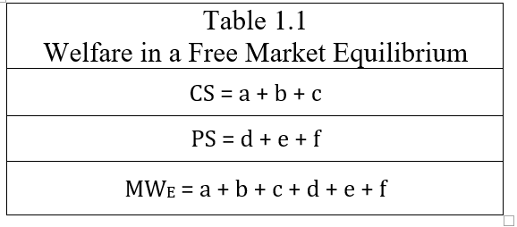
Welfare Effects of Price Ceilings
Compare a price ceiling to the free market

Slide 9
Welfare Effects of Price Ceilings
First consider maximum welfare effects → consumers who get the highest surplus are the ones who buy Q₁
This means we are assuming that we have some consumers with higher WTP (willingness to pay) and some with lower WTP
→ different preferences and/or different incomes among consumers

Slide 10
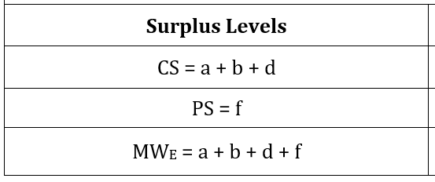
Welfare Effects of Price Ceilings
If consumers who get the highest surplus are the ones who buy Q₁
Then …..

Slide 11
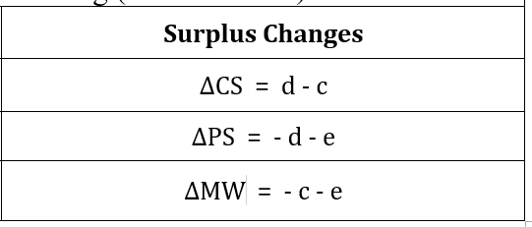
Welfare Effects of Price Ceilings
Surplus changes found as the difference in surplus from free market to the price ceiling

Slide 12
Welfare Effects of Price Ceilings
Next consider minimum welfare effects → consumers who get the lowest surplus are the ones who buy Q₁
These individuals are either poorer or have lower need/desires
Choose Q₃ such that Q₂ – Q₃ = Q₁
With linear demand, this assures us that
area a = area g

Slide 13
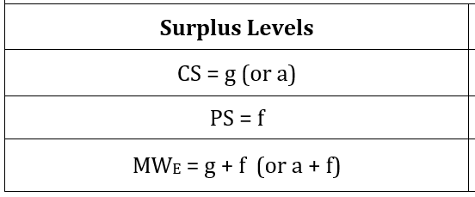
Welfare Effects of Price Ceilings
If consumers who get the lowest extra surplus are the ones who buy Q₁
Then …..

Slide 14
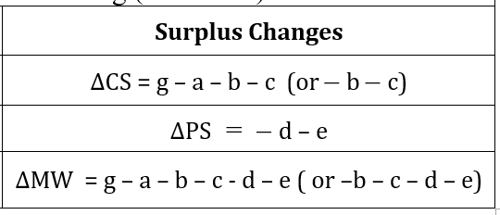
Welfare Effects of Price Ceilings
Surplus changes found as the difference in surplus from free market to the price ceiling
Recall area g = area a

Slide 15
Welfare Effects of Price Ceilings
A binding price ceiling causes reductions in economic efficiency or market welfare
The efficiency losses are larger when those who want or need the good least are the ones buying the good
Lines or queues means that allocation is random across different consumer WTPs
Quota tickets can assure a more equitable allocation but require administration costs … even then there are still efficiency losses
Key winners are the consumers lucky enough buy the product
Key losers are the firms and those consumers shut out of the market

Slide 16
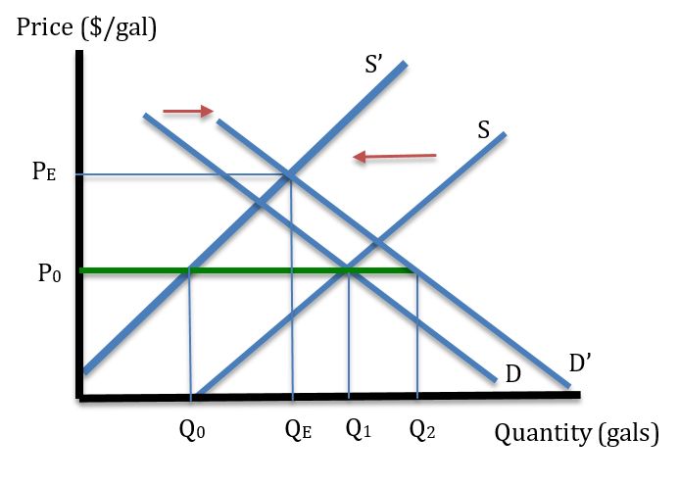
Price Gouging Laws
Market demand and supply often changes suddenly in emergencies such as hurricanes, snowstorms, etc.
Anticipation of supply disruption, or future price increase, causes both an increase in demand and a decrease in supply
There is pressure for the market price to rise even before the event (P₀ to P_{E})

Slide 17
Price Gouging Laws
The general public usually reacts strongly and negatively to price increases (often called price gouging)
Merchants selling gasoline, ice, chainsaws, generators, snow shovels, etc. are pressured not to raise prices.
Many states (~34) have price gouging laws to prevent these “unconscionable price increases”

Slide 18
Price Gouging Laws
A price gouging law acts like a price ceiling in emergencies
The intention is to prevent profiteering, keep essential items affordable, but does it improve the outcome for most people?
Must compare the outcome with a price ceiling to the outcome without a price ceiling.

Slide 19
If the Price Gouging Law is Enforced
Pros
Cons
Sense of Fairness
Profits to gas firms are normal. Price is not set way above the cost.
Some people who wait long in line get a small amount of gas at the usual price.
Disaster response based on altruism
Limited supply is allocated randomly and inefficiently by waiting in lines
Consumers’ time is wasted waiting in lines (high opportunity costs)
Violence sometimes occurs with line cutters, etc. (Police often assigned to keep order)
Some who don't need gasoline as much get it (eg. a retired grandma)
Some who need gasoline desperately don’t get it (eg. delivery vehicles)
No economic inducement to supply more gasoline faster / reliance on charity from the state or others.

Slide 20
No Price Gouging Law (Prices rise)
Pros
Cons
Shorter lines or lack of lines – less time wasted waiting (elimination of the opp. costs)
Those in highest need get gas (eg. delivery vehicles)
Those with lowest need don't buy it (eg. retirees) Precautionary demand stopped
Greater economic profit induces quicker increase in gas supply. The higher the price the faster the response. This means the shortage will disappear faster.
Determination of who gets the gas is based on self selection.
Charity can still operate to help those in need. (eg subsidies to buy gas)
Sense of injustice/unfairness
Wealthier can afford all the gas they desire
Poor may suffer more – not for sure though, since long lines are welfare reducing for poor too
Bad image for merchants

Slide 21
Is Price Gouging Self-interest or Greed?
Self Interest if,
Greed if,
Price changes are induced by changing market conditions
Many firms competing against each other to supply a good
All trade is mutually voluntary with good information about the products being sold.
Price changes induced by monopoly firms
Exchanges result in win-lose outcomes
Violation of market ethics: ie. presence of theft, threats, deception, or broken promises

Slide 22
Economic Misinformation causes Inefficiency
The General Public believes,
Firms are greedy; greed is bad
Price increases are an expression of greed
Price gouging results in an unfair price because it is set way above the cost of production
Suffering people, especially the poor cannot afford higher prices
Desire to prevent unfairness inspires public calls for price gouging laws
The government gains popular support by enacting price gouging laws

Slide 23
Economic Misinformation causes Inefficiency
The Economics Lesson,
Monopoly pricing is price gouging. This is greedy and economically inefficient
A price increase in emergencies is not price gouging. It is an efficient market allocation method for goods in short supply
A price increase, and the resulting profit, stimulates new supply
A price increase curtails precautionary and non-essential demand
A price increase eliminates the cost of waiting in lines
Most people will suffer less with a price increase
However, economic explanations in opposition to price gouging laws are very unpopular!!

